Slide 1
Automated Build and Test
Steve Jones
Editor, SQLServerCentral
Red Gate Software

Slide 2
Goals
Why continuous integration?
Testing is important
It’s easy – setup and running in an hour
Do feel free to ask questions!

Slide 3
Introduction
Steve Jones
Editor and Founder, SQLServerCentral
Evangelist, Red Gate Software
23 years experience with SQL Server
Contact
@way0utwest (Twitter)
http://www.linkedin.com/in/way0utwest
www.voiceofthedba.com
SQLServerCentral (sjones@)

Slide 4
What is continuous integration?
“Continuous Integration is a practice designed to ensure that your software is always working, and that you get comprehensive feedback in a few minutes as to whether any given change to your system has broken it.”
Jez Humble, ThoughtWorks, author of “Continuous Delivery”

Slide 5
database
^
What is continuous integration?
“Database Continuous Integration is a practice designed to ensure that your database software is always working, and that you get comprehensive feedback in a few minutes as to whether any given change to your system has broken it.”
Jez Humble, ThoughtWorks, author of “Continuous Delivery”

Slide 6
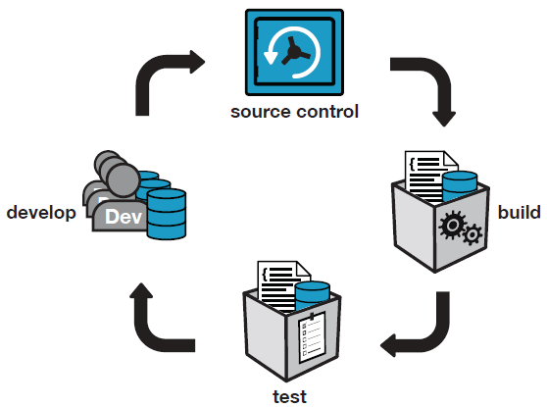
Database Continuous Integration
Notes:
CI server is set up by one person and the whole team of developers benefits.

Slide 7
What is build?
For application code = compile
For database code = database creation script
But only for a new installation!
Upgrade scripts required for existing installations
Need to preserve the state of the data
Notes:
The testing of deployment scripts is customarily left to the end.
=> Issues with upgrades only found at the end of a project.

Slide 8
Tools we need
CI server
Perform the build for us
Execute steps we program
Choices
TeamCity by JetBrains
Jenkins – open source
Bamboo – Atlassian
TFS Build - Microsoft
Cruise Control – open source
Notes:
Show of hands for SQL Developer Bundle.
TeamCity is used at Red Gate but *any* build server can be used, eg:
Jenkins, Hudson, TFS Build, CruiseControl, Bamboo, etc.
There is a sqlci.exe command line, and NAnt and MSBuild template wrappers available.

Slide 9
Tools we need
CI server
Perform the build for us
Execute steps we program
Choices
TeamCity by JetBrains
Jenkins – open source
Bamboo – Atlassian
TFS Build - Microsoft
Cruise Control – open source
Notes:
Show of hands for SQL Developer Bundle.
TeamCity is used at Red Gate but *any* build server can be used, eg:
Jenkins, Hudson, TFS Build, CruiseControl, Bamboo, etc.
There is a sqlci.exe command line, and NAnt and MSBuild template wrappers available.

Slide 10
Tools we need
Database Integration
Check out schema from VCS
Execute against a SQL Server instance.
Run tests
Choices
Red Gate SQL Automation Pack
PoSh
.NET scripts/program
?
Notes:
Show of hands for SQL Developer Bundle.
TeamCity is used at Red Gate but *any* build server can be used, eg:
Jenkins, Hudson, TFS Build, CruiseControl, Bamboo, etc.
There is a sqlci.exe command line, and NAnt and MSBuild template wrappers available.

Slide 11
Tools we need
Version Control
Store our database DDL and DML
Choices
Subversion
Team Foundation Server
Git
Mercurial
Visual SourceSafe
?
Notes:
Show of hands for SQL Developer Bundle.
TeamCity is used at Red Gate but *any* build server can be used, eg:
Jenkins, Hudson, TFS Build, CruiseControl, Bamboo, etc.
There is a sqlci.exe command line, and NAnt and MSBuild template wrappers available.

Slide 12
Tools we need
Testing framework
We need a way to unit test our code easily.
A framework allows us to write tests that we can maintain
Choices
tSQLt and SQL Test
TSQLUnit
TST
Notes:
Show of hands for SQL Developer Bundle.
TeamCity is used at Red Gate but *any* build server can be used, eg:
Jenkins, Hudson, TFS Build, CruiseControl, Bamboo, etc.
There is a sqlci.exe command line, and NAnt and MSBuild template wrappers available.

Slide 13
Tools we need
Test data
We want to have data for our tests
Choices
Red Gate SQL Data Generator
Restore known backup
Custom scripts for data load (DML and or BCP)
Notes:
Show of hands for SQL Developer Bundle.
TeamCity is used at Red Gate but *any* build server can be used, eg:
Jenkins, Hudson, TFS Build, CruiseControl, Bamboo, etc.
There is a sqlci.exe command line, and NAnt and MSBuild template wrappers available.

Slide 14
Demo
Continuous Integration Setup

Slide 15
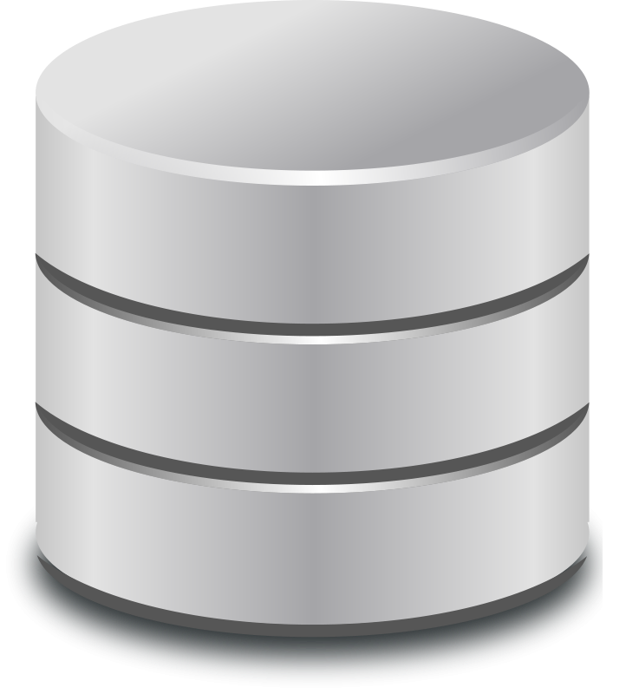
The CI Database Setup
Repository
CI Server
Developer
Integration Database

Slide 16
The CI Database Setup
Repository
CI Server
Developer
Integration Database

Slide 17
The CI Database Setup
Repository
CI Process
CI Server
Developer
Integration Database

Slide 18
The CI Database Setup
Random Test Database
Repository
CI Process
CI Server
Developer
Integration Database

Slide 19
The CI Database Setup
Repository
CI Process
CI Server
Developer
Integration Database

Slide 20
Keeping a database up to date
With?
Schema
Static data
Why?
A corresponding database for the application
Maintaining a test database with the latest changes

Slide 21
Testing
Why it’s important

Slide 22
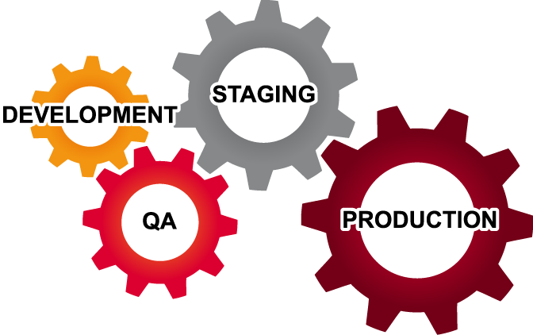
Where does testing happen?
Testing isn’t just done in QA
Be aware of the cost of fixing a bug
Notes:
There are pre-dev phases where testing could also happen –requirements analysis, architecture, functional specification.

Slide 23
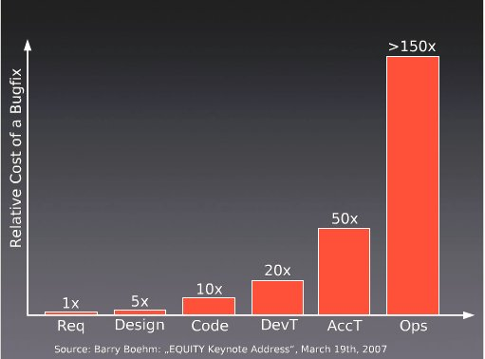
Cost of Bugs

Slide 24
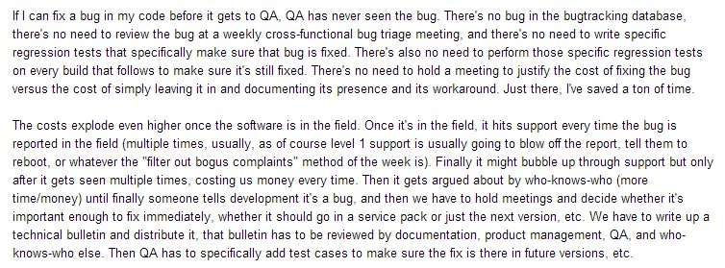
Does the cost of bugs rise?

Slide 25
Does the cost of bugs rise?

Slide 26
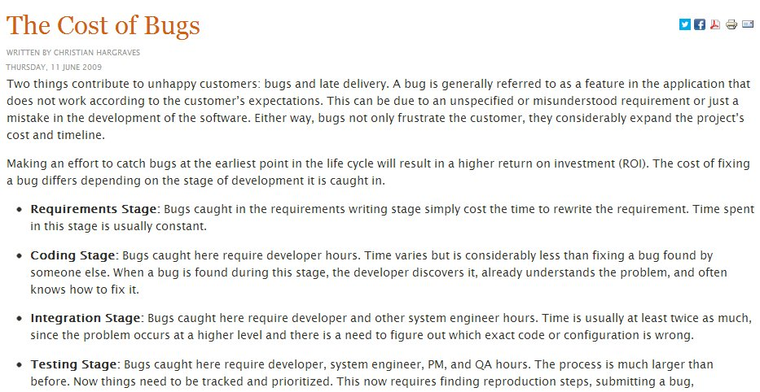

Slide 28
Testing in Development
Low(er) costs
No inter-team interactions
Changes are discrete
However
Increased frequency of changes (higher cost)
Notes:
Testing in development is preferred as the costs as low, or relatively low compared to finding bugs and issues later.
The lower costs come because testing is done in one team, or with one person. The changes are also discrete in that there aren’t a large bundle of changes being put together over time for deployment. Small bits of change are occurring.
However there are more changes, which means more costs to the tests and running a suite of tests.
The key here is automation.

Slide 29
What is test?
For .NET code, Nunit
Runs on a developer’s machine and build server
What about the database?
tSQLt is an open source framework for testing SQL Server databases
tSQLt.org
Support via GoogleGroups
SQL Test provides SSMS integration
Notes:
Although CI catches issues that arise when developers have failed run tests locally, also solving a different problem:
- Two incompatible changes committed by different developers
- “Works on my machine” in development.
Issues that only arise in more realistic integration environments.

Slide 30
Demo
Testing the Build

Slide 31
Why generate test data?
Dev environments are often not realistic
Getting production data not always possible
Random data can result in surprises
Volume testing can find performance issues

Slide 32
Demo
Testing with larger data sizes

Slide 33
Two bugs found by Test Data
NULL Dates
App code assumed [Date] wouldn’t be NULL
Test data didn’t
Fix was to change [Date] to be NOT NULL
Performance of v_Articles
Test passed on dev box
Failed in more “realistic” CI environment

Slide 34
Deployments Scripts
Creation scripts
For new installations
Upgrade Scripts
For existing installations
Developed by comparing our up-to-date database to production/test
Notes:
Creates database packages, used for reliable and repeatable deployments

Slide 35
Next Steps
Notes:
http://www.manageware.co.il/solution/portfolio/auto-deploy/

Slide 36
The End
Questions?
More information: www.red-gate.com/CI
Please fill out your feedback forms
www.voiceofthedba.com/talks

Slide 37
References
http://assets.red-gate.com/products/sql-development/assets/continuous-integration-using-red-gate-tools.pdf
http://www.jetbrains.com/teamcity/
http://developers.slashdot.org/story/03/10/21/0141215/software-defects---do-late-bugs-really-cost-more
http://tech.lds.org/index.php?option=com_content&view=article&id=238:the-cost-of-bugs&catid=1:miscellanous
http://www.manageware.co.il/solution/portfolio/auto-deploy/

